Slide 1
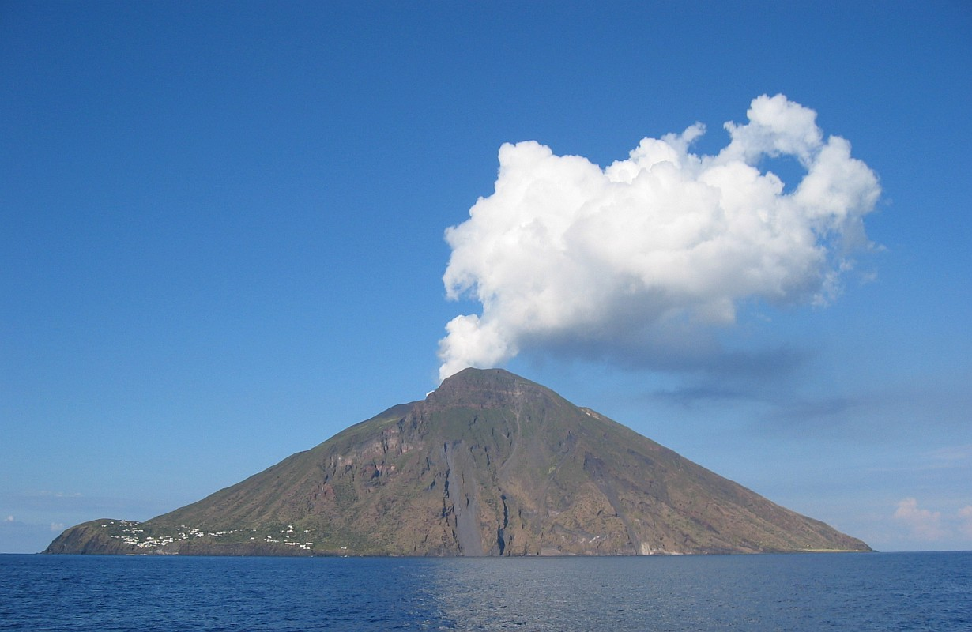
Úvod do sopek
Notes:
AUTHORS: Geoffrey Cromwell (Scripps Institution of Oceanography, UC San Diego), Danny Blas (Abraham Lincoln High School, San Diego, CA)
WHY: Different types of volcanoes erupt in different ways, some more violently than others. This lesson will show you how to tell the difference between explosive and non-explosive volcanoes and what each different volcano type is made of. This is important to know if you ever live or travel near an active volcano.
SUMMARY (< 100 words): This lesson presents three types of volcanoes (shield volcano, stratovolcano, and cinder cones) and explores their relative compositions, size and explosivity. Of the three types of volcanoes, shield and stratovolcanoes are the most common and therefore the lesson activity/summary focuses only on those two types. Three take home messages: 1) Shield volcanoes are non-explosive, very wide with shallow slopes, made up of lava, 2) Stratovolcanoes are explosive, steep sided and cone shaped, made of alternating layers of lava and pyroclastics (ash, rock fragments).
PICTURE/GRAPHICS CREDITS: Photo is of the Stromboli volcano off the coast of Sicily, Italy. From http://en.wikipedia.org/wiki/File:DenglerSW-Stromboli-20040928-1230x800.jpg
Stromboli has been erupting near-constantly, with small, mildly explosive (strombolian-type) eruptions, for thousands of years. The Romans called it the lighthouse for Naples because they could see it erupt at night every few minutes and from there they just had to go east to arrive at Naples.
WEBSITES USED IN THIS PRESENTATION:
ADDITIONAL READING: See TEACHING NOTES
CONTEXT FOR USE: This lesson is designed for a 9th grade Earth Science class and is the first lesson in a weeklong Volcanoes Unit. The presentation and activity in this lesson will fit a class period of about 55 minutes. The next lesson in the series is titled: “Volcanic Hazards”.
MISCONCEPTIONS: All volcanoes erupt violently; Volcanoes are made only of cooled lava; All volcanoes are cone shaped with steep sides; The largest volcanoes in the world are found on land; Shield volcanoes are always non-explosive
EVALUATION TIPS: You may give an example for a pre/post evaluation that you provided, with a link to the file provided with your lesson materials
TEACHING NOTES. This presentation is designed to precede a classroom activity where students apply what they learn about shield volcanoes and stratovolcanoes. Instructions for this activity are in the document titled “VolcanoType_PosterActivity”. Unless otherwise noted, all information in this lesson was derived from Wikipedia.com or a college level Earth science textbook titled:
Earth, Portrait of a Planet - Third Edition
Stephen Marshak
Copyright 2008 by W. W. Norton & Company, Inc.

Slide 2
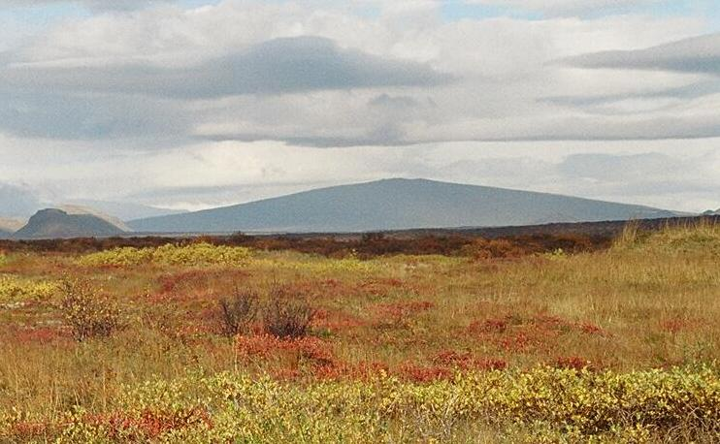
Štítová sopka
Štítová sopka
Jako štít vojáka
Široká základna, mírně ukloněné svahy
Vytváří vysoce pohyblivou lávu (málo viskózní)
Většinou neexplozivní sopky
Notes:
This slide shows an image of a typical shield volcano and give some general characteristics of this volcano type.
Image of the Skjaldbreidur volcano in Iceland. This is a sub-aerial shield volcano. Shield volcanoes have wide bases with shallow slopes. They are much wider relative to their height
Shield volcanoes are named as such because they resemble a round soldiers shield laying on the ground. A wide base with shallow slope, the peak of the shield is not very high relative to the diameter
Shield volcanoes form from the eruption of voluminous lava flows that spread out over a large area. Fast flowing lava allows eruption events to spread over a large area, this is necessary to form the wide bases of shield volcanoes
These volcanoes are mostly not explosive, they are relatively calm and produce lava that erupts “gently”. Shield volcano eruptions can occur for several days, weeks, even months (i.e. Kilauea, Hawaii)
Explosive eruptions can occur when magma of a shield volcano mixes with water (groundwater or seawater). No volcano is always non-explosive.
The above image is from Wikipedia, http://en.wikipedia.org/wiki/File:Skjaldbreidur_Herbst_2004.jpg
2

Slide 3
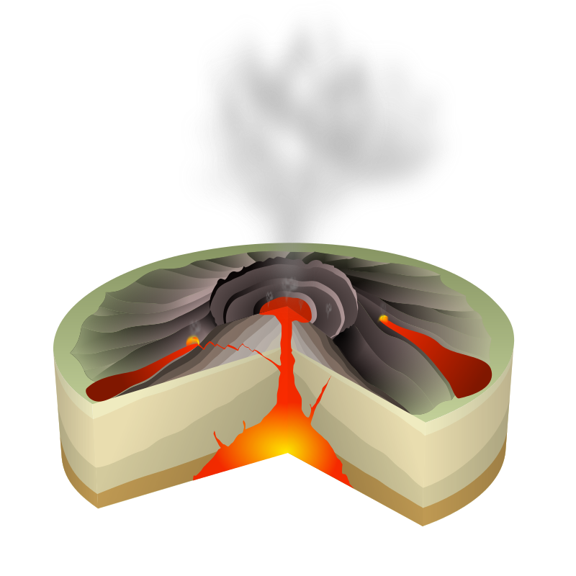
Stavba štítové sopky
mrak sopečného popelu
Štítová sopka
Vrstvy ztuhlé lávy
Erupce mohou nastat na vrcholu sopky nebo z postranních trhlin
Největší vulkány na Zemi i ve sluneční soustavě
Mauna Loa, Havaj: 300 km široká základna (na mořském dně)
kráter
lávové jezero
lávový proud
geologické vrstvy
magmatický krb
sopečný komín
Notes:
This slide illustrates the general composition of a shield volcano and how it erupts
The photograph is a generalized cartoon of a shield volcano showing layers of cooled lava (6) , the magma chamber(source of volcanic material) (11), the summit caldera and central vent (where the majority of lava erupts) (3, 4), and flank eruptions or side vents (where eruptions commonly occur) (2,6). Other features: ash plume(1), lava fountain (2), fumaroles (5), layers of lava and ash (7), stratum (8), sill (9), magma conduit (10), dike (12)
Shield volcanoes consist of layers of cooled lava from different eruptions
Volcanoes generally erupt through the central vent, but flank or side eruptions are very common and are characteristic of shield volcanoes.
Shield volcanoes are some of the largest on Earth when you take into consideration total height from the base to the summit. In the case of Mauna Loa (and all the Hawaiian Islands for that matter), the base of the volcano is about 300 miles in diameter and the summit rises several miles above the sea floor.
Above image from Wikipedia, http://en.wikipedia.org/wiki/File:Hawaiian_Eruption-numbers.svg
3

Slide 4
Lava ze sopky Kilauea, Havaj
Notes:
This slide is a youtube video showing the effusive and fast flowing nature of some lava flows from Kilauea, Hawaii. These types of eruptions are very common on shield volcanoes. The black film on top of the lava flows are portions of the flow that cooled from contact with the air.
Video from: http://www.youtube.com/watch?v=5hE2DZdl0IA
4

Slide 5
Video erupce sopky Kilauea z dronu
http://earthref.org/SCC
Scripps Classroom Connection
Notes:
This slide is a youtube video of aerial footage from a recent Kilauea eruption. It is important to highlight how far the lava is flowing, the high volume of lava, and the overall scale of the event.
This video from: http://www.youtube.com/user/ActualidadRT?v=n61bHSCygSE&feature=pyv&ad=7259836166&kw=volcanos
5

Slide 6
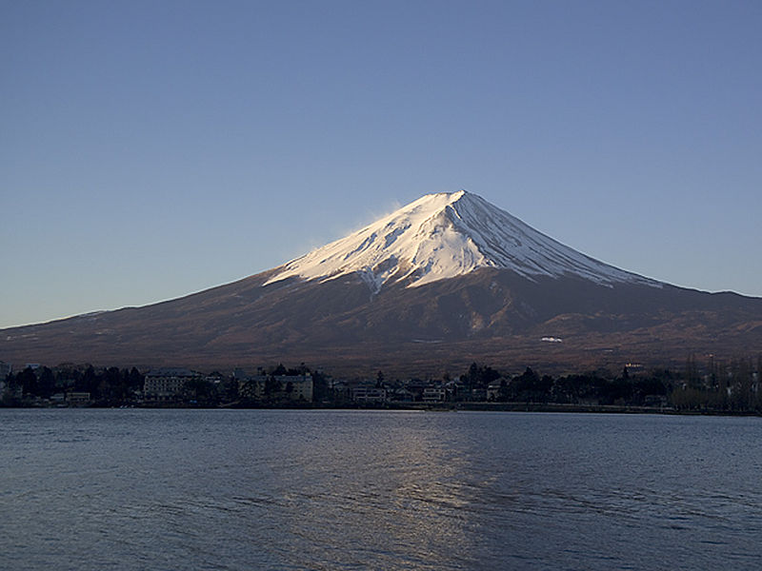
Stratovulkán
Stratovulkán
Klasický vzhled sopky
Mírný svah na bázi, příkrý svah na vrcholu
Střídání vrstev lávy a sopečného popelu
Explozivní
Notes:
This slide highlights the shape of this type of volcano and its general composition.
The above image is of Mt. Fuji in Japan. It is an active stratovolcano.
Stratovolcanoes are the classic image of volcanoes, seen in cartoons, textbooks, photographs. They are cone shaped, have gentle slopes at the base but steep slopes as you approach the summit.
Stratovolcanoes are made of both lava and pyroclastics (rock fragments from explosive eruptions, including ash, larger debris, mud). Pyroclastic flows will be explained in detail in the next lesson, however it is worth giving a brief description here. Pyroclastic flows are essentially avalanches of hot volcanic material, cooled lava fragments mixed with hot gasses that storm down the volcano.
Stratovolcanoes are highly explosive and can be very dangerous, especially because of their pyroclastic flows. Hazards of stratovolcanoes will be discussed in more detail in the next lesson.
The above image is from Wikipedia, http://en.wikipedia.org/wiki/File:FujiSunriseKawaguchiko2025WP.jpg
6

Slide 7
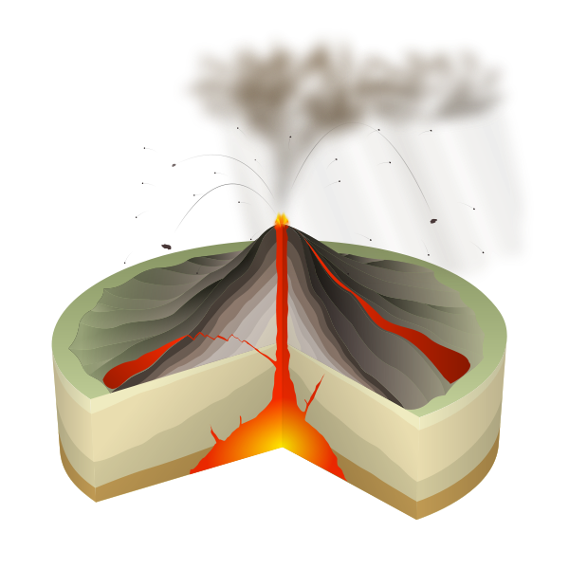
Stratovolcano structure
mrak prachu a plynů
kráter
vrstvy lávy a popela
lávový proud
geologické vrstvy
magmatický krb
sopečný komín
Notes:
This slide contains an illustration of a stratovolcano and the material ejected during an eruption. The image shows alternating light and dark layers of pyroclastics and lava flows (7, 9), respectively, the magma chamber (1), conduit (3) and side vents (6,11). Similar to shield volcanoes, most material is from the central vent (13), with flank vents (11) playing secondary rolls in volcanic activity. Other features: bedrock (2), base (4), sill (5), flank (8), throat (10), parasitic cone (11), lava flows (12), crater (14), ash cloud (15). The image highlights the explosivity of stratovolcanoes by showing a large ash cloud (15), along with volcanic debris being ejected from the central vent.
The above image is from Wikipedia, http://en.wikipedia.org/wiki/File:Volcano_scheme.svg
7

Slide 8
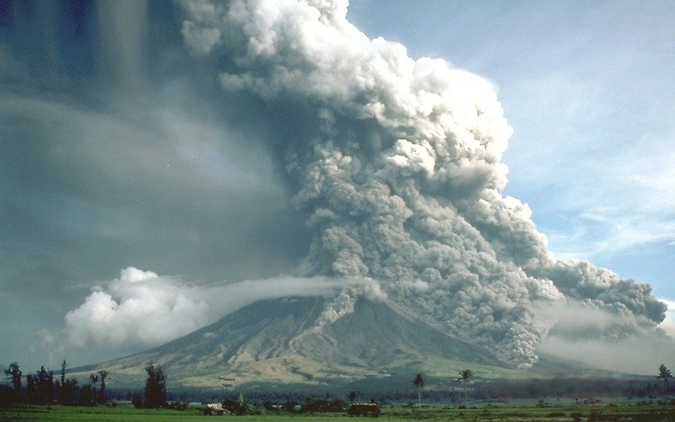
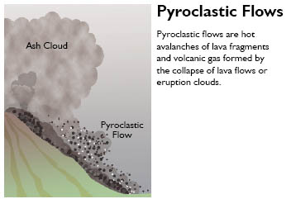
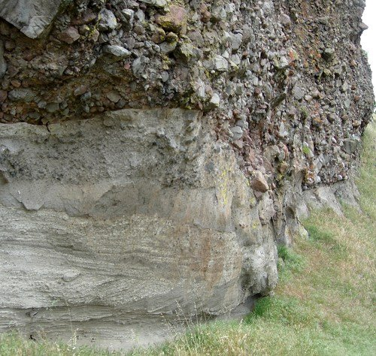
Proud obsahuje směs sopečného popelu a úlomků ochlazené lávy.
Proud horkých plynů a popelu
Notes:
This slide shows a cartoon of a pyroclastic flow (top left), in addition to real life examples. The image in the top right shows an actual eruption of the Mayon volcano in the Philippines with its pyroclastic flow labeled. The bottom right image is of a cooled pyroclastic flow overlaying a mud flow. This is likely from a stratovolcano.
Pyroclastic flows contains a mixture of volcanic ash and larger fragments of cooled lava.
Pyroclastic layer on top of mud: Image copyright 2007 by Andrew Alden, geology.about.com, reproduced under educational fair use.
http://geology.about.com/od/geology_ca/ig/sutterbuttes/sutbutlahar3.htm
Pyroclastic flow cartoon: http://www.ncgeology.com/Eno_interactive_webs/Geologic_Principles_igneous%20rocks.html
Pyroclastic flow image of Mayon volcano during eruption: http://en.wikipedia.org/wiki/File:Pyroclastic_flows_at_Mayon_Volcano.jpg
8

Slide 9
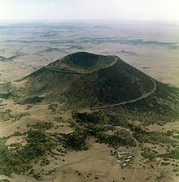
Sypaný kužel
Sypaný kužel
Rovnoměrný kuželovitý tvar
Příkré svahy
Tvořen sopečným popelem a úlomky lávy
Vysoce explozivní
Notes:
This slide describes the a third type of volcano, cinder cones. Cinder cones are quite common and are unique since they can be found as small individual volcanoes (such as Paricutin volcano in a farmer’s field in Mexico) or as small volcanoes on larger ones (both strato and shield volcanoes). Unlike strato and shield volcanoes, they are not really a major identifying class of volcano, but are important since they are so common.
Cinder cones are very steep sided with a larger central crater (formed during eruptions)
They have very steep sides from the base to the summit
Cinder cones are made of fragmented bits of solidified lava (cinder) and they are very difficult to climb (think of climbing a steep cone of loose sand)
Cinder cones are explosive. The tops and sides of cinder cones are often blown out during eruptions due their explosivity and from the wind deflecting the eruption column of material.
The image is of a cinder cone with a large central crater.
Image from Wikipedia, http://en.wikipedia.org/wiki/File:Capulin_1980_tde00005.jpg
9

Slide 10
Závěry
3 typy sopek
1. Štítové sopky
-vrstvy lávových proudů, neexlozivní
2. Stratovulkán
-střídání vrstev lávy a popelu, explozivní
3. Sypaný kužel
- popel a úlomky lávy, explozivní
Notes:
The take home message for this presentation are the three types of volcanoes and their characteristics. The major points are listed in the slide above. The goal of this Volcano Unit, which this lesson is apart of, is to explore explosive and non-explosive volcanoes. In order to simplify this message all future lessons will focus on Shield and Stratovolcanoes only, ignoring Cinder Cones (since they are not a major volcano type).
An activity is designed to follow this presentation. The activity is titled “VolcanoTypes_PosterActivity”. See that file and the Teacher Notes for this lesson (“VolcanoTypes_Notes”)

